Slide 1
OPERATION & METRIC ANALYTICS
Project Description:
Approach:
Requirement:
This project(OPERATION & METRIC ANALYTICS) is all about analysis for the complete end to end operations of a company. With the help of this, the company then finds the areas on which it must improve upon. This kind of analysis is further used to predict the overall growth or decline of a company’s fortune.
We are going to create a Database in MySQL workbench and use MySQL queries to find out the required data from the data stored in the Database.
We are going to find some Insights such as “NO OF JOBS REVIEWED”, “THROUGHPUT”, “PERCENTAGE SHARE OF EACH LANGUAGE”, “DUPLICATE ROWS”, “USER ENGAGEMENT”, and some metrices like “USER GROWTH”, “WEEKLY RETENTION”, “WEEKLY ENGANGEMENT”, “EMAIL ENGAGEMEMT”.
Tech-Stack Used:
MySQL Workbench 8.0 CE, to run MySQL Queries.

Slide 2
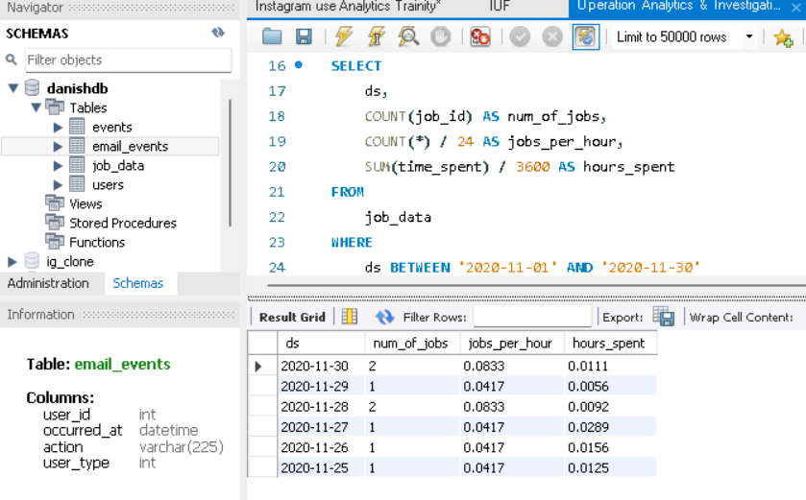
OPERATION & METRIC ANALYTICS
Insights:
MySQL Query & Result:
NUMBER OF JOBS REVIEWED:
We have to calculate the number of jobs reviewed per hour per day for the last 30 days’ .
A simple query in MySQL will display the result as shown in the picture

Slide 3
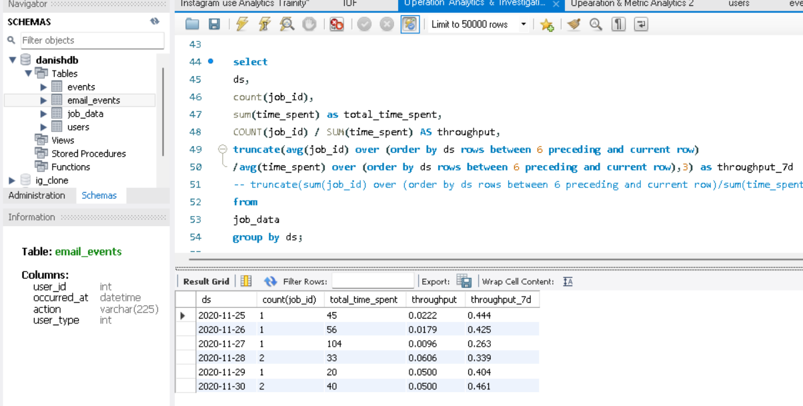
OPERATION & METRIC ANALYTICS
Insights:
MySQL Query & Result:
THROUGHPUT:
We have to find ‘No of events happening per second’ and ‘7 day Rolling Average and compare both to find the better Indicator’.
A simple query show in the picture helps us understand the data.
We would prefer 7 day rolling average because Rolling Average are useful for finding long term trends otherwise disguised by occasional fluctuations.

Slide 4
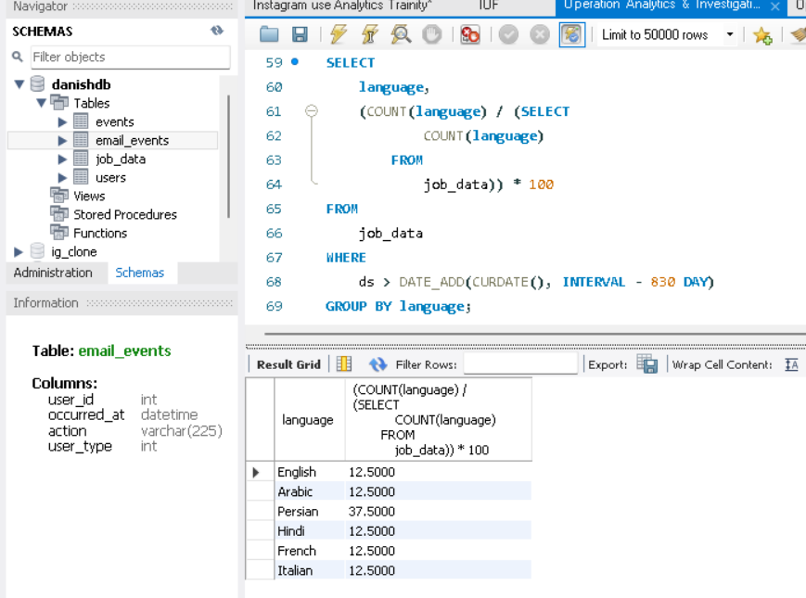
OPERATION & METRIC ANALYTICS
Insights:
MySQL Query & Result:
PERCENTAGE SHARE OF EACH LANGUAGE:
We have to find ‘Percentage Share of each Language for last 30 days’.
The MySQL query show in the picture gives the data for the percentage share of each language for the last 30 days. ‘Persian’ language has been used the most.

Slide 5
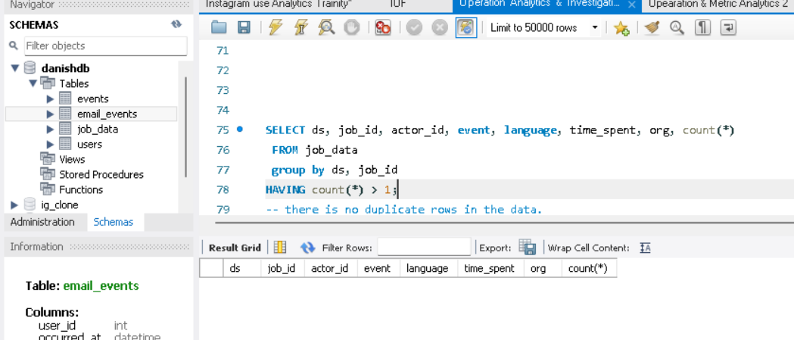
OPERATION & METRIC ANALYTICS
Insights:
MySQL Query & Result:
DUPLICATE ROWS:
We have to find ‘How to display duplicate rows if there is any’.
The given table does not have any duplicate rows so no data is displayed but if there is any duplicate data this query from the picture will help in finding it. Duplicate rows is very harmful while deriving insights for future use.

Slide 6
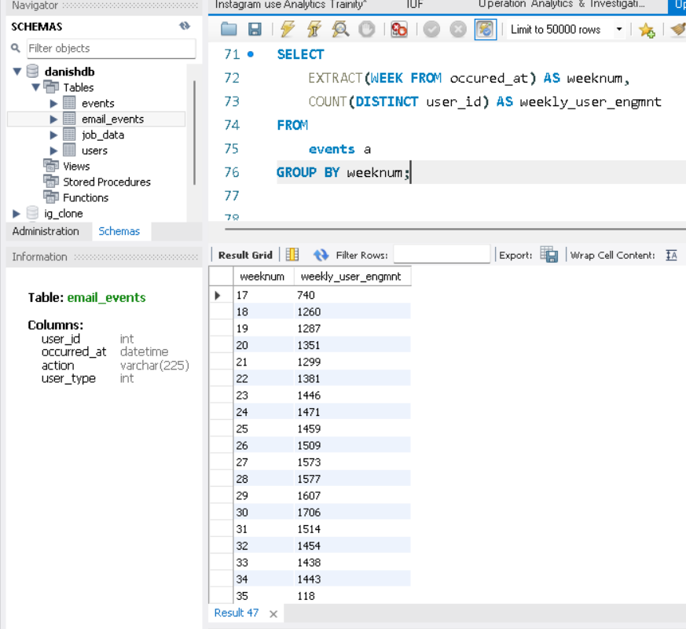
OPERATION & METRIC ANALYTICS
Insights:
MySQL Query & Result:
USER ENGAGEMENT:
We have to find ‘Weekly User Engagement’. The data will tell us about how many users are engaging with the platform on weekly basis.
A simple query shown in the picture displays the required data..

Slide 7
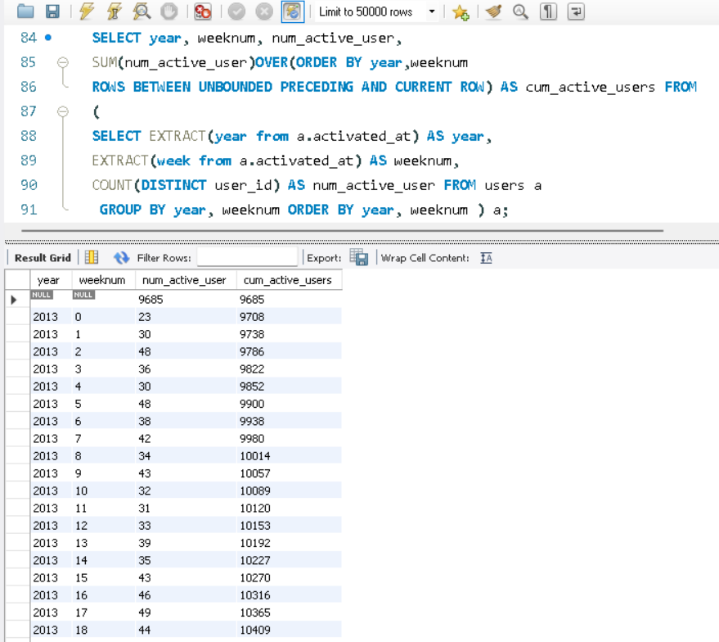
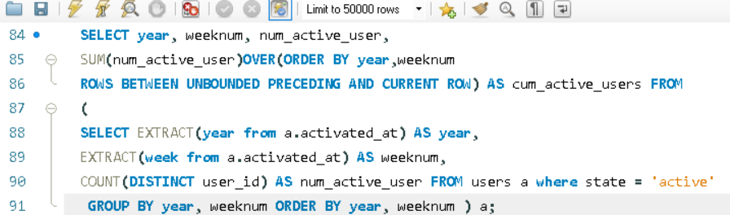
OPERATION & METRIC ANALYTICS
Insights:
MySQL Query & Result :
USER GROWTH:
We have to find the ‘User Growth for the Product’ to understand the amount of users growing over time..
A simple query has displayed the result as shown in the picture..

Slide 8
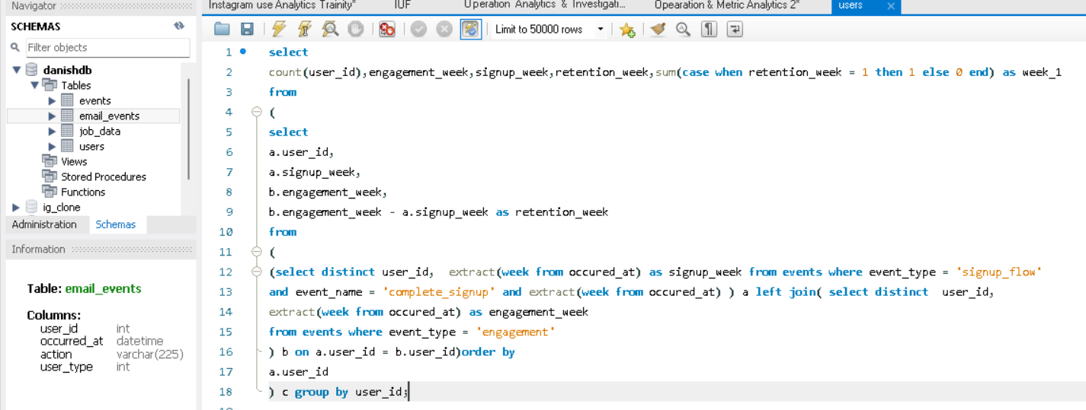
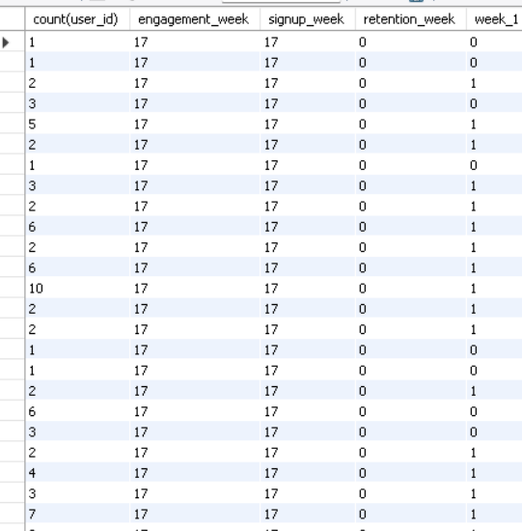
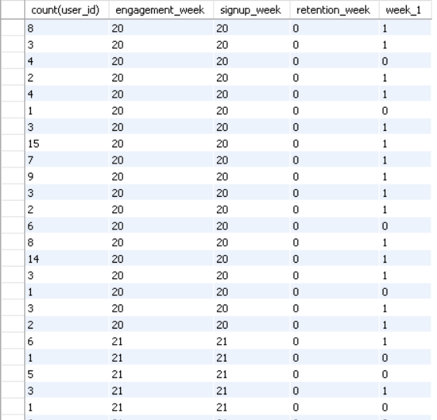
OPERATION & METRIC ANALYTICS
Insights:
MySQL Query & Result :
WEEKLY RETENTION:
We have to find ‘Weekly Retention of user sign up cohort’ to get the data for users getting retained weekly after signing up for a product .
To derive a query for this we need to understand ‘COHORT ANALYSIS’ first. The query for this data has been shown in the picture..

Slide 9
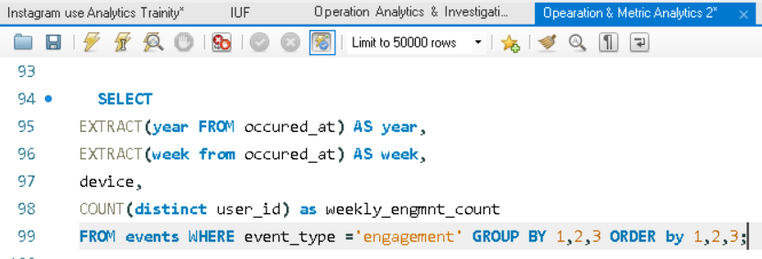
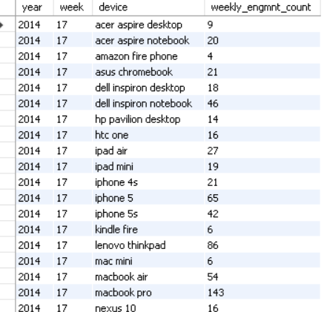
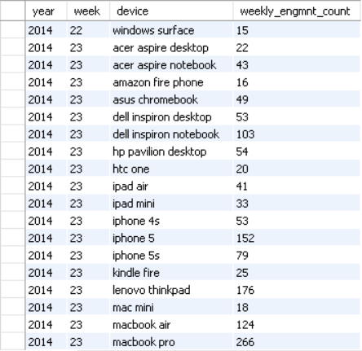
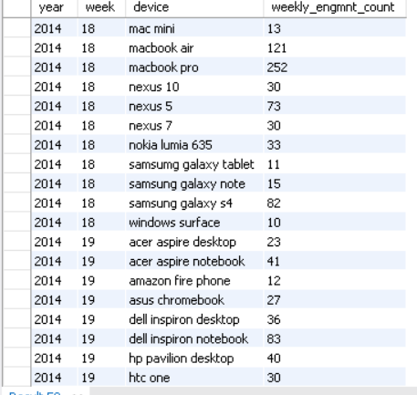
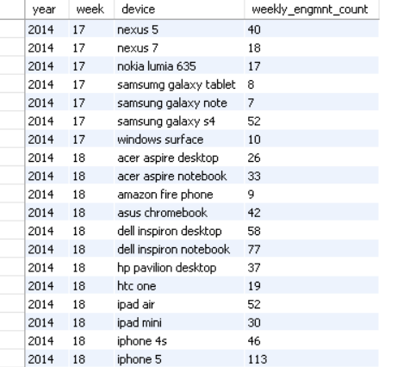
OPERATION & METRIC ANALYTICS
Insights:
MySQL Query & Result :
WEEKLY ENGAGEMENT:
We have to measure ‘if the user finds quality in the product/services weekly’ to calculate the weekly engagement per device.
The query and result has been displayed in the picture. The list is very long a part of answer is shown in the picture

Slide 10
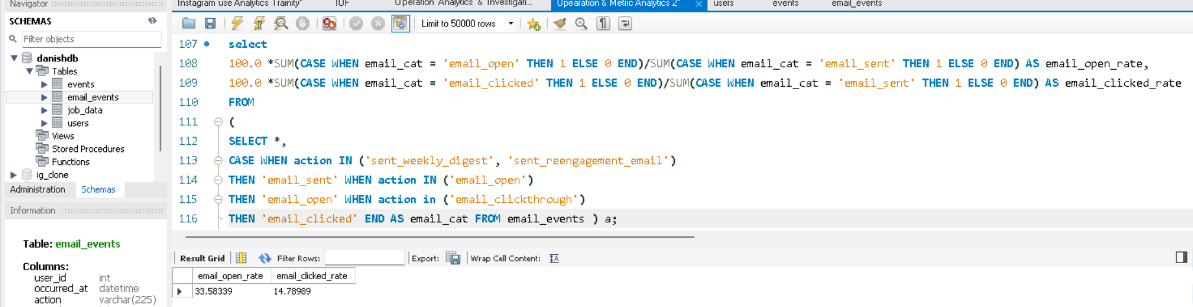
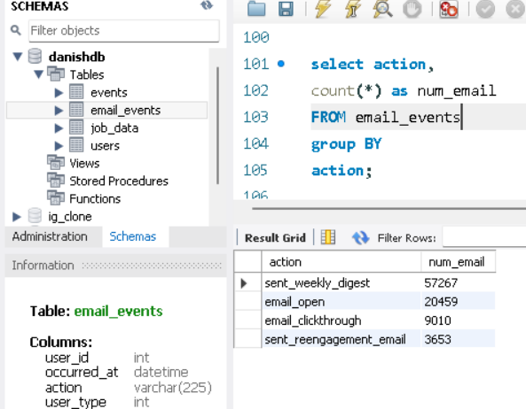
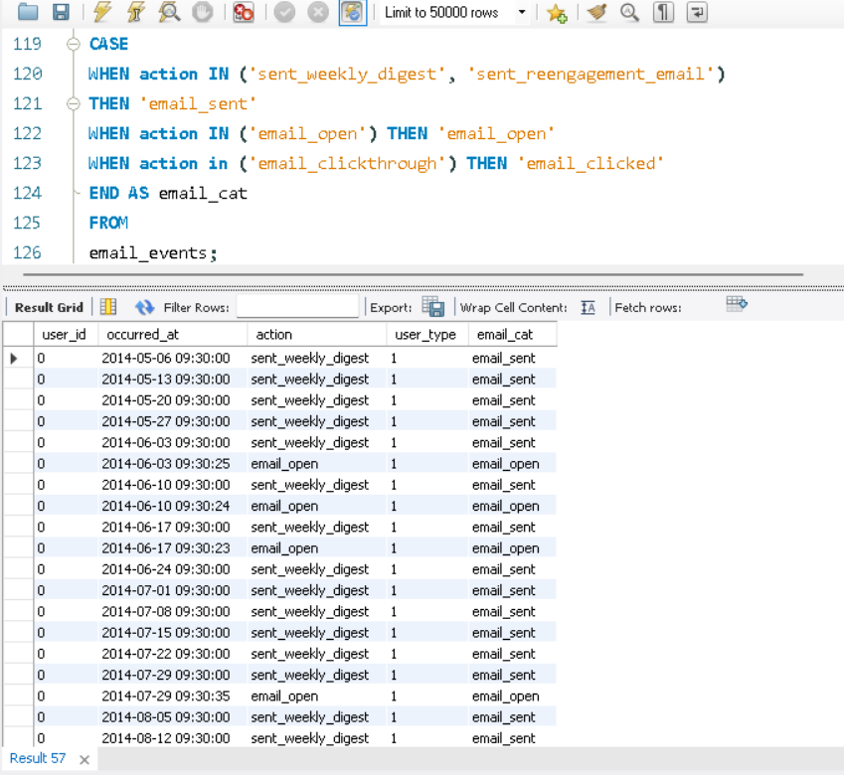
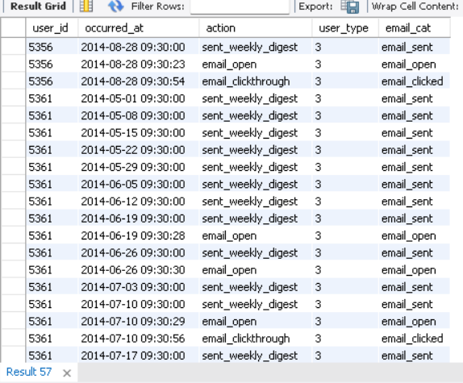
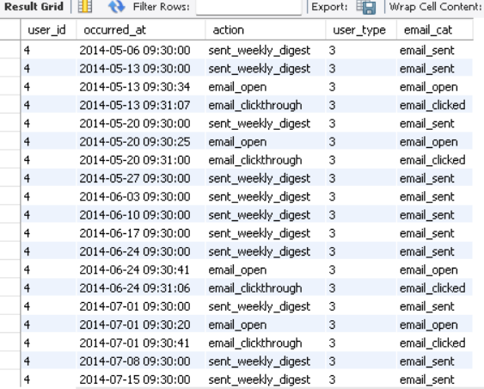
OPERATION & METRIC ANALYTICS
Insights:
MySQL Query & Result :
EMAIL ENGAGEMENT:
We have to find ‘Email Engagement Metrics’ to get the data for users engaging with email services.
The query and result has been displayed in the picture. List is very long but some answer has only been shown in the picture

Slide 11
OPERATION & METRIC ANALYTICS
Takeaway:
How to get insights about the requirement to run a business.
How to calculate Retention Ratio of users and their engagement on a weekly/yearly/daily basis.
How to run a business using analytics.
What is Cohort Analysis and how does it work.

